Slide 1
First Sponsor Demo
Norbert Szücs
Pallida Cohort - Static Class
Notes:
In 1642 a young French mathematician gentleman, Blaise Pascal has invented a mechanical machine which was able to do simple mathematical operations such as addition and subtraction. It was such a big tool, though. After centuries, thanks to the developed technology, in the 1970’s, an American company has invented the hand-held and improved version of it. This is the calculator we know today. Welcome ladies and gentleman, my name is Norbert and today I will talk about this incredible tool.

Slide 2
Previous experience
Training
Teamwork
Travelling

Slide 3
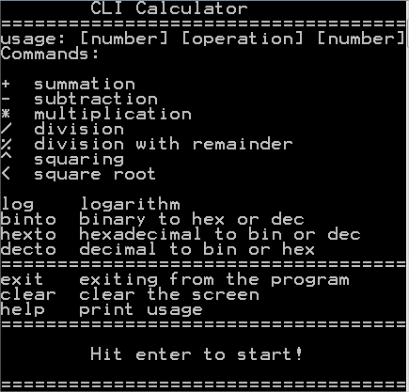
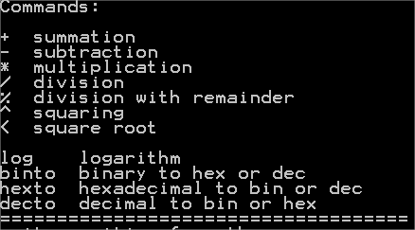
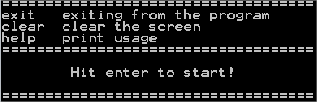
CLI Calculator Basics
User interface
Commands
Menu points

Slide 4
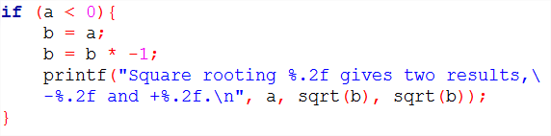
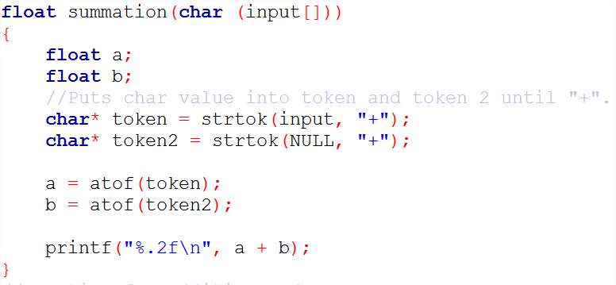
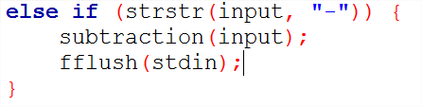
CLI Calculator Challenges
Exceptions
Commands
Operator order

Slide 5
CLI Calculator Future plans
Currency converter
Data from external source
Automatized data update

Slide 6
Thank you for your attention!

